Slide 1
Heart Attack Prediction using FastAPI and Machine Learning

Slide 2
Tools
Pandas (pd): Used for data manipulation and analysis.
NumPy (np): Provides support for large, multi-dimensional arrays and matrices.
Seaborn (sns) and Matplotlib (plt): Used for data visualization.
Scikit-learn: Provides tools for machine learning, including model training and evaluation.
FastAPI: Used to create a web API for the machine learning model.
Pydantic: Used for data validation and serialization.

Slide 3
Heart Attack Prediction
Heart attacks are a leading cause of death worldwide
Early prediction and treatment can save lives
Machine learning can help predict heart attack risk based on patient data

Slide 4
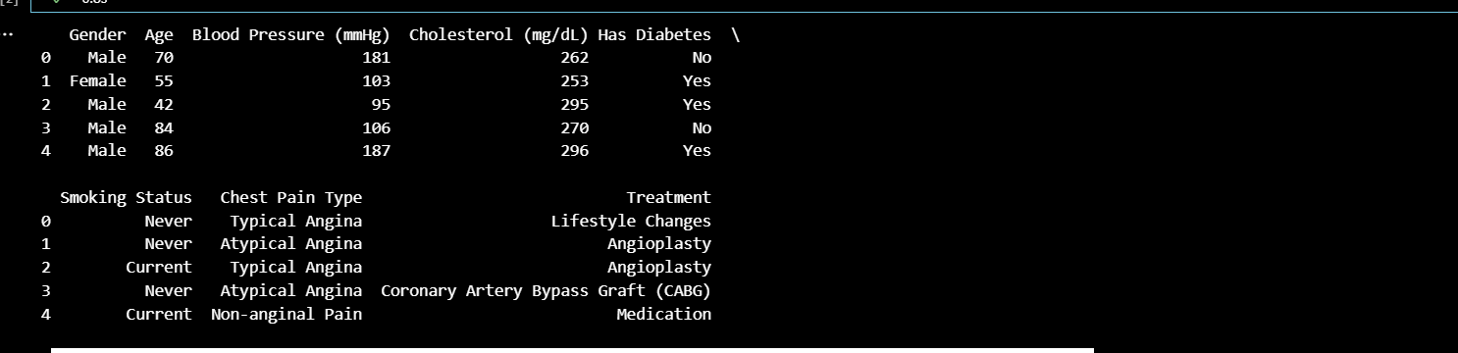
Heart Attack Dataset
The dataset contains 13 features and 1 target variable (Treatment)
Features include medical, and lifestyle factors
The dataset is used to train a machine learning model to predict treatment

Slide 5
Data Preprocessing
Handling missing values using dropna()
Converting categorical variables to numeric using LabelEncoder
Selecting only numeric columns for analysis
# Check for missing values and drop them if necessary
data = data.dropna()
# Convert categorical variables to numeric using LabelEncoder
categorical_columns = ['Gender', 'Has Diabetes', 'Smoking Status', 'Chest Pain Type']
label_encoders = {}

Slide 6
Data Visualization
Visualizing the distribution of Age using sns.histplot()
Visualizing Blood Pressure by Gender using sns.boxplot()
The box for Gender = 0 will represent the distribution of blood pressure values for males.
The box for Gender = 1 will represent the distribution of blood pressure values for females.
Red tones indicates positive correlation
Blue tones indicates negative correlation

Slide 7
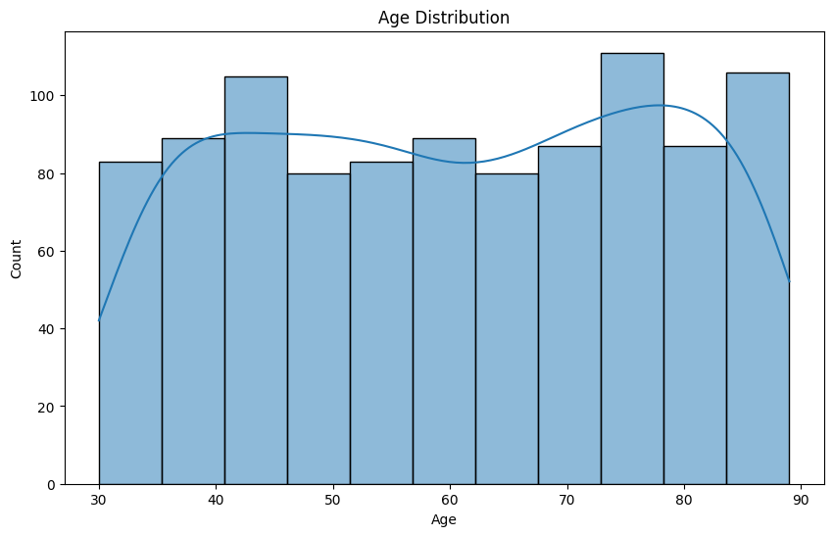

Slide 8
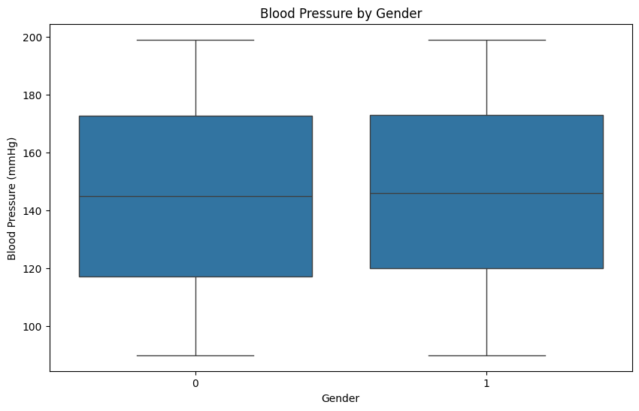

Slide 9
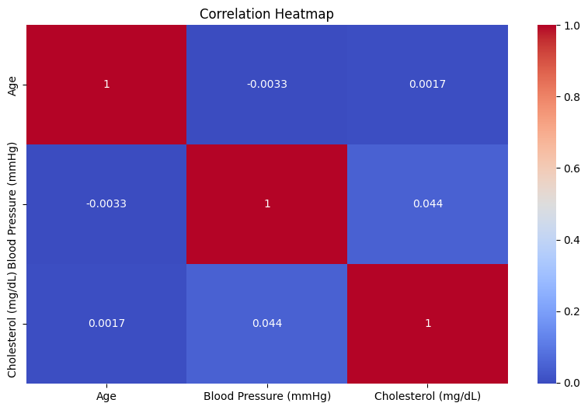
Correlation Analysis

Slide 10
Logistic Regression Model
Training a logistic regression model using LogisticRegression()
Evaluating the model using accuracy score
Achieving an accuracy of 0.24

Slide 11
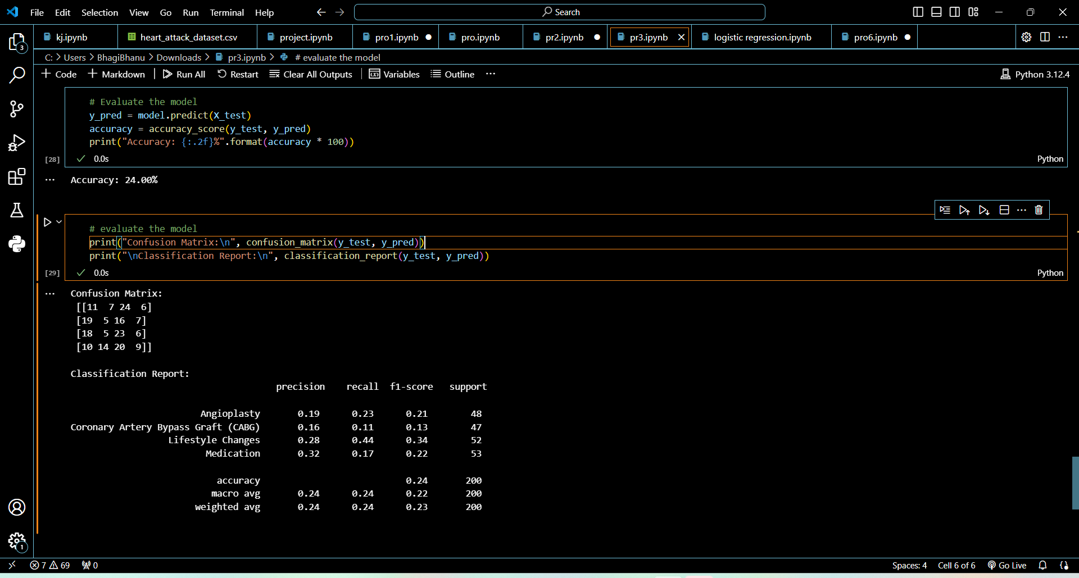
Classification Report

Slide 12
Treatment
Reduce risk of heart attack or stroke: By opening up blocked arteries, angioplasty can reduce the risk of heart attack or stroke.
Improve quality of life: Angioplasty can improve overall quality of life by reducing symptoms and improving physical function.
Coronary Artery Bypass Graft (CABG) is a medical procedure to improve blood flow to the heart
Lifestyle Changes Being active and doing regular exercise will lower your blood pressure by keeping your heart and blood vessels in good condition.Regular exercise can also help you lose weight, which will help to lower your blood pressure

Slide 13
Conclusion
Developed a machine learning model to predict heart attack treatment
Created a FastAPI web API for predicting treatment based on patient data
Demonstrated the potential of machine learning in healthcare

Slide 14
THANK YOU

